Slide 1
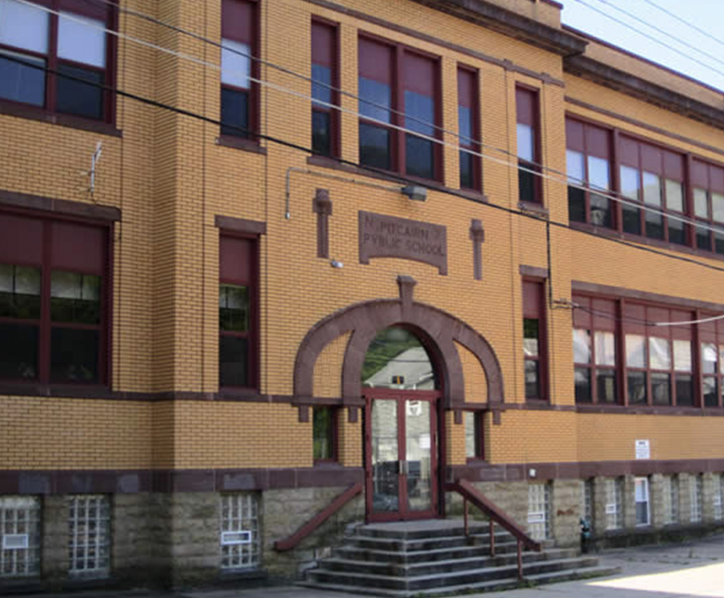
Luke Healey
Internship Site: | Propel Pitcairn Elementary School, Pittsburgh, PA
School District: | Propel Charter Schools, Pittsburgh, PA
On-Site Supervisor: | Ariane Watson
Superintendent/CEO | Dr. Tina Chekan

Slide 2
Focus Question: What is the relationship between the EBLI Reading Strategy and Reading Proficiency as measured by NWEA MAP scores and DIBELS progress monitoring?
This past school year, my school made a significant investment to train all English-Language Arts teachers in the process known as Evidence-Based Literacy Instruction (EBLI). The amount spent was $16,000 by my school, which was not in the budget. I am hoping to see if this was a justifiable expense through my research. I will be examining the following categories
DORF Words Correct
DORF Accuracy
DORF Retell
DORF Retell Quality
DCS
DIBELS Oral Reading Frequency (DORF)
DIBELS Composite Score

Slide 3
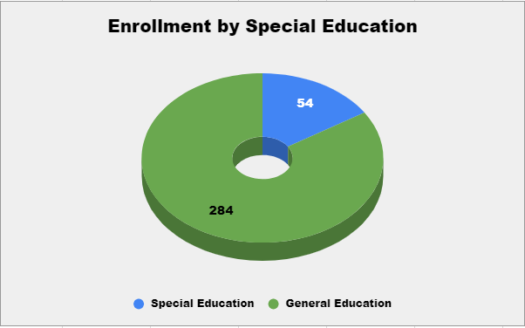
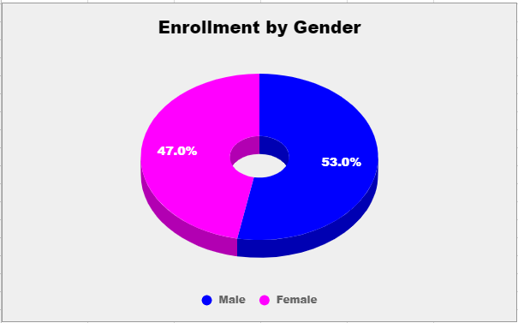
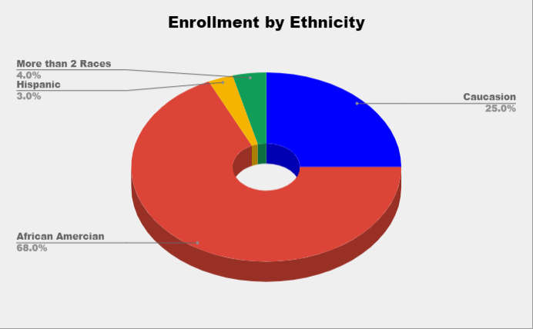
Propel Pitcairn Elementary School Demographics
Source: Performance Profile. (n.d.). Retrieved July 24, 2018, from http://www.paschoolperformance.org/Profile/27609

Slide 4
How Did I Get My Results?
Met with Ariane Watson (Principal) to determine what would be a good topic to research
Met with Kaitlin Anselmo (Instructional Coach) and Kimberly Hoerr (Title I Coordinator).
Examined DIBELS and NWEA MAP data from the beginning and end of the year for pull-out EBLI and non-pull out EBLI instruction
Created a spreadsheet using average scores of different categories to compare EBLI vs. Non-EBLI students.
Identified what trends I wanted to look for after examining the focus question and the data.
After identifying the trends found in the data, I developed solutions to help improve the success of ALL students.

Slide 5
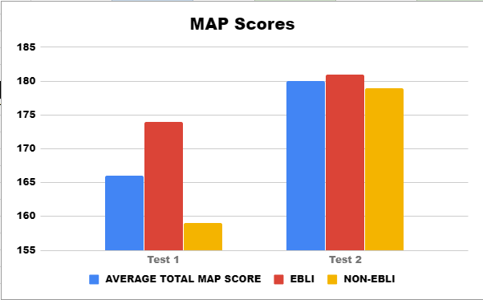
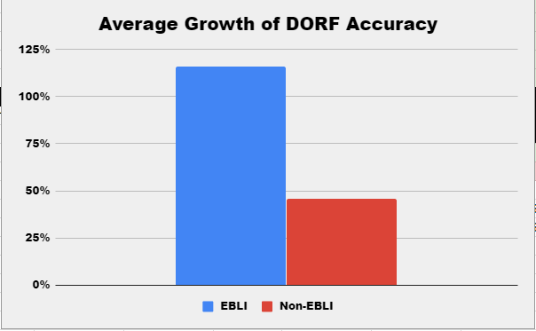
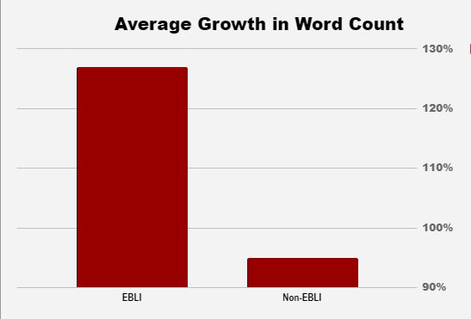
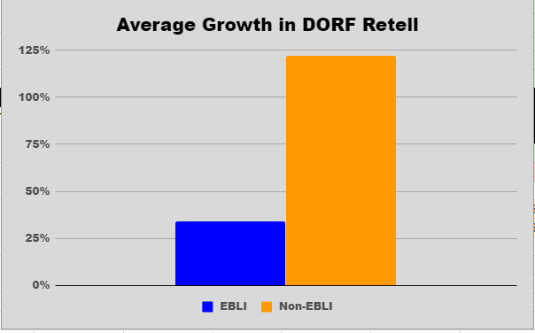
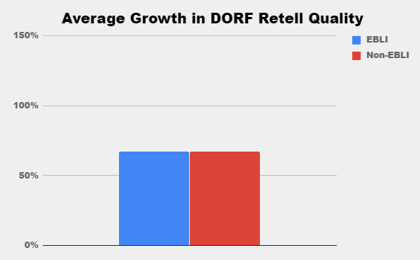
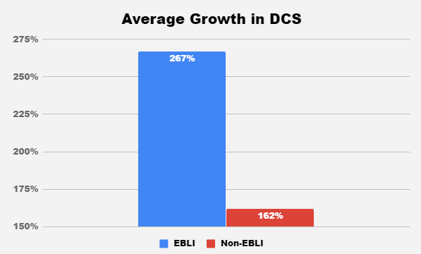
What Did I Discover?

Slide 6
Overall Trends
Pull out EBLI Instruction students scored ____________ than Non-EBLI instruction students over the course of the year.
32% Higher on DORF Word Count
70% Higher on DORF Accuracy
193% Higher DIBELS Composite Score
Non-EBLI student scored ___________ than EBLI Instruction students
88% Higher DORF Retell
Both EBLI and Non-EBLI students had the same average growth of 67% for Retell Quality.

Slide 7
What can we do?
Identify and implement strategies that we can incorporate the EBLI style pull-out instruction with ALL students.
Identify why Non-EBLI instruction students scored substantially higher on the Retell than EBLI students and implement interventions to close this gap.
Develop a system on how to develop other teachers in the district who are not trained in EBLI to become trained to support our students needs.

